Slide 1
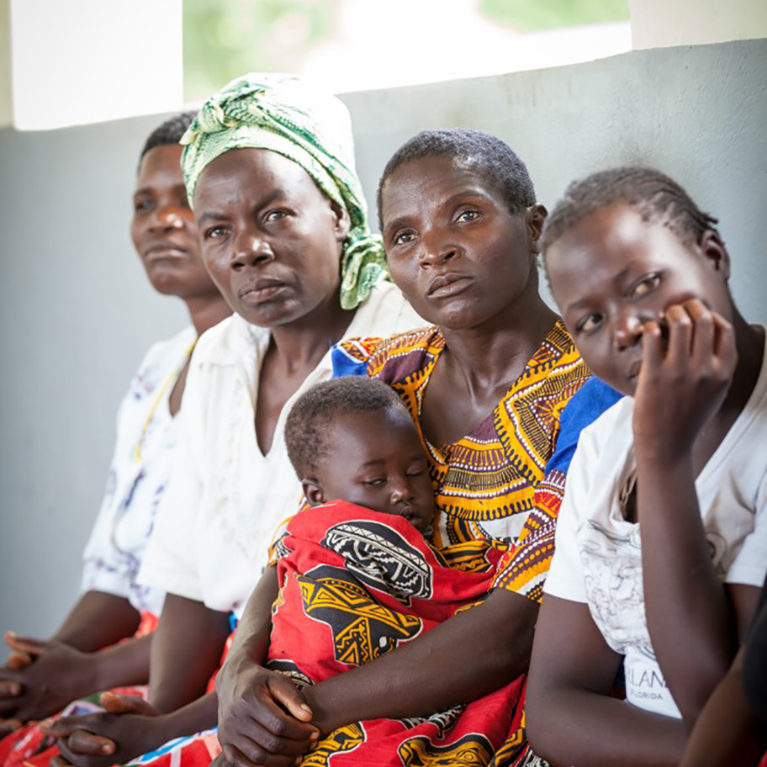
Results and learnings from the malaria Quality of Care program in Kano state Nigeria-Implications for severe malaria
Dr Koki Abdullahi
CMO-KANO SMEP
Xxxxxx
xxxx

Slide 2
Discussion outline
Kano state malaria epidemiology
Challenges in managing severe malaria in children U5
Background on the Quality-of-Care work in Kano state
Lessons learned and opportunities for improving severe malaria outcomes

Slide 3
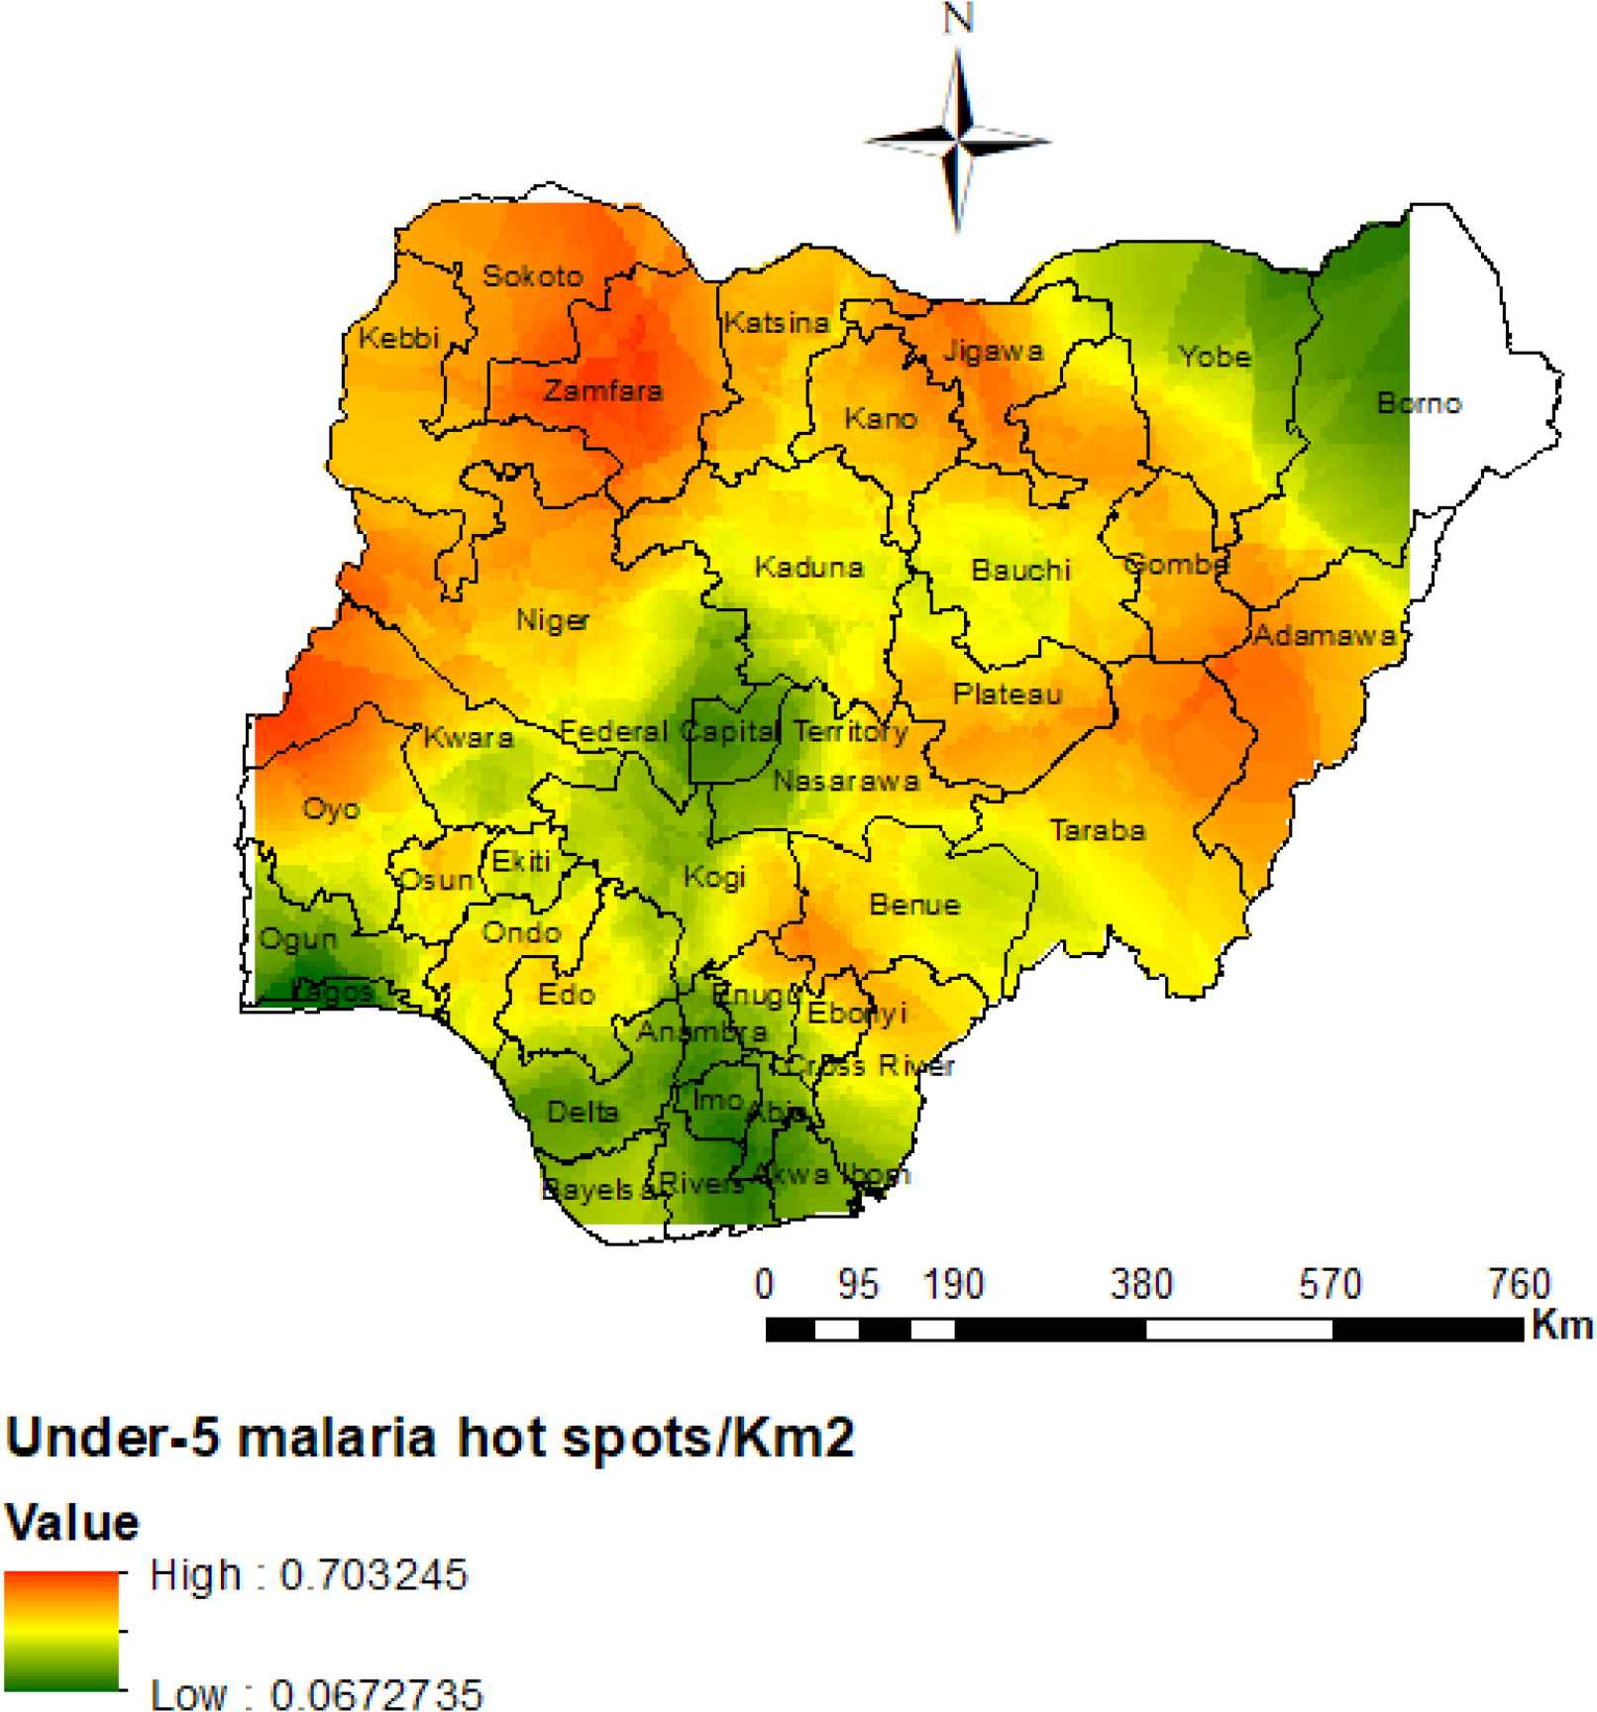
Kano State context and health performance
Demography
Kano Malaria Epidemiology
Malaria test positivity rate, 2020¹
Malaria burden in Nigeria³
Kano is located in the North West region of Nigeria and has 3 senatorial zones: Kano North, Central and South
Kano is the second most populous state in Nigeria with over 13 million people. Over 50% of the population is between 15-64 years
Contribution to Nigeria malaria cases burden, 2020¹
Health indices
Infant mortality rate in 2020 (national average -15.5)¹ 4.3
9.67%
Under 5 Mortality Rate (all causes)² 109 deaths/1000 live births
Malaria prevalence according to rapid diagnostic test
Only 5% of children age 12-23 months received all recommended vaccinations by 1st birthday, 17% Pentavalent vaccine coverage⁴
The Kano state Government and other supporting partners have made significant efforts to reduce malaria burden in the state
However, significant gaps that affect population health outcomes still exist
High out of pocket expenditure is a barrier to care. 75% OOPE in Nigeria and malaria is a big contributor
43%
1. National Bureau of Statistics, Nigeria- https://nigeria.opendataforafrica.org/, https://www.citypopulation.de/php/nigeria-admin.php?adm1id=NGA019
HMIS; 3 DHS 2018, 4 MIC-NIS 2016-2017
Under 5 malaria hot spots in Nigeria: Epidemiology and control profile of malaria in Nigeria
3

Slide 4
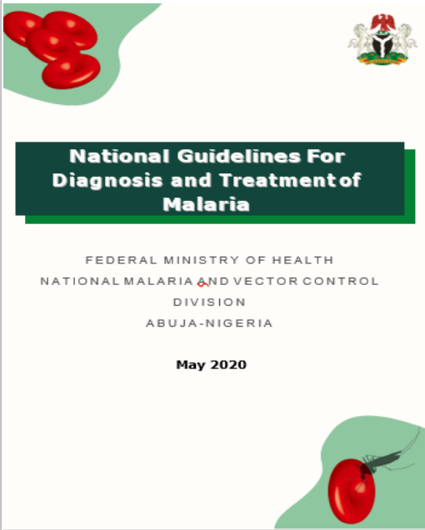
Despite the availability of clear guidelines on malaria case management, malaria Quality of Care in Kano state is suboptimal…
To ensure optimal Malaria QoC, the guidelines re-emphasize the need for specific antimalarial treatment, the capacity to manage complications and the ability to monitor or provide other forms of supportive care…
Nigeria updated its Malaria QoC guidelines in 2020
Key recommendations for severe malaria include:
If diagnosis confirmation is not immediately feasible, treatment should commence while appropriate specimen should be obtained for subsequent testing
All cases of severe malaria should be treated with I.V or I.M Artesunate for at least 24 hours
Where Artesunate is not available, severe malaria can be treated with Injection Artemether or Quinine as alternatives
In 2020, cross sectional surveys from SHFs in the state identified:
64% of the severe malaria cases were treated according to the guidelines¹
Artesunate treatment for confirmed severe malaria patients was suboptimal (59.6%)²
98% of HCWs had never used Rectal Artesunate Capsule (ARC)²
Only 4.4% of positive patients with severe malaria were treated with recommended oral ACT as a follow up
Malaria QoC survey In 3 selected LGA’s Madobi, Dawakin Tofa and Kano municpal
1. Ojo, A.A., Maxwell, K., Oresanya, O. et al. Health systems readiness and quality of inpatient malaria case-management in Kano State, Nigeria. Malar J 19, 384 (2020). https://doi.org/10.1186/s12936-020-03449-5

Slide 5
Continuum of care for severe malaria in Kano state and challenges
CARE SEEKING AND REFERRALs
TREATMENT
POST REFERRAL/DISCHARGE
Delayed presentation: days after onset; home treatment/self medication
Inappropriate care seeking: PPMV’s or traditional medicine sellers where QOC and care practices are poor
Patients are usually admitted 5-7 days from onset of symptoms
Most patients are given either IM artemether or AL, as pre-referral treatment
High focus of EMS systems on MNH services and not for children U5. Affects timely referrals
Most patients receive a malaria diagnostic (usually RDT) test prior to admission/treatment initiation which can lead to delays in treatment initiation
Artesunate Inj and ARC not commonly used due to high cost and lack of availability
Injectable quinine is a third line choice when injectable AS and artemether do not work, or reserved for pregnant women
Oral treatment is prescribed for most patients for a duration of 3 days, but often not adhered to by patients
At discharge, most providers scheduled patients for a post treatment malaria parasitological test to be performed within 2 weeks post-discharge.
Few patients return for post treatment appointments
….High mortality amongst hospitalized severe malaria cases is due to late care seeking & referral and inability to pay for treatments

Slide 6
The Kano SMEP is working with CHAI to improve case management through strengthening key aspects of QoC and data use
Kano malaria QoC interventions
Objectives
Outputs
Outcomes
The QoC is intervention is implemented in 2 LGAs Madobi & Dawakin Tofa (28PHCs and 2 SHFs)
A baseline assessment was conducted that elucidated significant challenges:
Only 64% of the severe malaria cases in SHFs were treated according to the guidelines
Challenges with data collection, review and use processes
In response, the state has implemented the following:
Developed a malaria QoC dashboard
Reactivated and set up facility level QI teams
Developed & Rolled out state QoC quality improvement plan
Strengthen coordination structures for QoC
Improved coordination of malaria QoC interventions as a component of state QoC strategy
Malaria QoC integrated within the state’s QoC framework
Impact
Build healthcare worker capacity through training & targeted supportive supervision
Increased provider competency for data reporting and standards of care for case management
Improved adherence to malaria case management guidelines
Improved malaria case management outcomes
Improved quality of reported malaria data on the HMIS & LMIS
Improve availability of key malaria data via easy-to-use DHIS2 dashboards.
Improved SMEP’s capacity for targeted monitoring and follow-up
Improved use of malaria data for decision making
Data review meetings re-focused to probe data accuracy
Reduced discrepancies in reported data

Slide 7
There are opportunities to improve management of severe malaria cases and leverage on lessons learned from previous work
Lack of prioritization of SHFs in case management trainings which have focused mostly on PHCs
Low availability of treatment guidelines at service levels leads to delayed treatment initiation and poor adherence to treatment guidelines
Sub-optimal availability of other supportive treatments e.g. lack of adequate Oxygen supplies at EPUs to manage hypoxemia
High attrition of trained HCWs contributes to poor treatment capacity across SHFs
Deploying a peer-led learning approach is an effective and efficient way of building HCW capacity
Lessons learned
Future opportunities/ Planned work
Deploy strategies for improving Case Management of Malaria such as:
Integrate the malaria peer-led learning modules into the state’s peer-led-learning platform
Activate facility QI teams for malaria case management
Conduct facility-level mentoring and follow-up in each facility
Institute monthly clinical meetings in secondary health facilities to improve adherence to treatment protocols and improve treatment outcomes

