Slide 1








ASTMH Symposium 145:
Supporting Quality and Child Friendly Malaria Interventions
Management of severe malaria cases:
learnings and challenges from the field
Manuel Hetzel
on behalf of the CARAMAL Project consortium*
With funding from

Slide 2
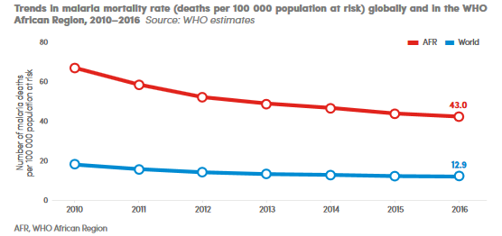
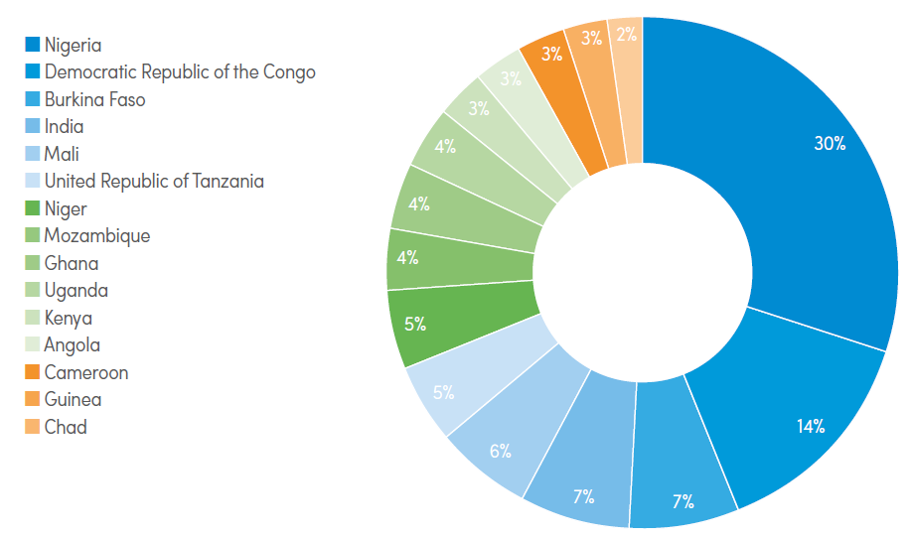
Severe malaria – a medical emergency
445’000 malaria deaths in 2016 80% in 15 countries
World Malaria Report 2017, WHO
Notes:
Malaria deaths have fallen over the past decade but pocmets of high malaria burden and high mortality remain – largely untackled.
Three countried contribute half of all global malaria deaths: Nigeria, DRC, Burkina Faso.
However: these estimates are are likely not completely accurate as deaths in the community may be underestimated.

Slide 3

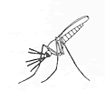

Severe malaria – unknowns
Moderately
severe disease
Infection ➔ mild disease ➔ severe disease ➔ death
Incidence of severe malaria, esp. in remote communities
Predictive symptoms and danger signs, risk factors, probabilities of disease progression
Case fatality
Treatment seeking behavior
Availability, quality and uptake of different treatment options
Especially at community/peripheral level
Notes:
Currently, WHO guidelines distinguish between mild/uncomplicated malaria, severe (incl. cerebral) malaria, malaria death.
A classification is important and useful for clinical management and reporting.
But: it is a continuum.

Slide 4
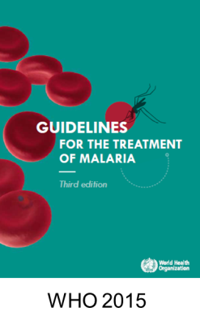
Severe malaria treatment – prevent death and disability
parenteral artesunate for at least 24 hours, then
full course of artemisinin-based combination therapy (ACT)
Where full treatment is not available:
Pre-referral treatment:
Single dose of i.m. artesunate, immediate referral
or
Single dose of rectal artesunate (RAS), immediate referral (age <6 years)

Slide 5
Rectal artesunate (RAS) in health system context
RAS was shown to reduce death and permanent disability in patients <6 years who take longer than 6 hours until reaching referral facility (Gomes et al 2009)
  In Zambia, introduction of RAS and strengthened referral was followed by decreased case fatality at health facilities (MAMaZ Against Malaria)
  Implementation model requires/assumes (i) functioning community case management system, (ii) linear functioning referral system, and (iii) adequate post-referral care
  To date, no large-scale evaluation of the health impact and health systems effect of routine introduction of pre-referral RAS in real-world setting.

Slide 6
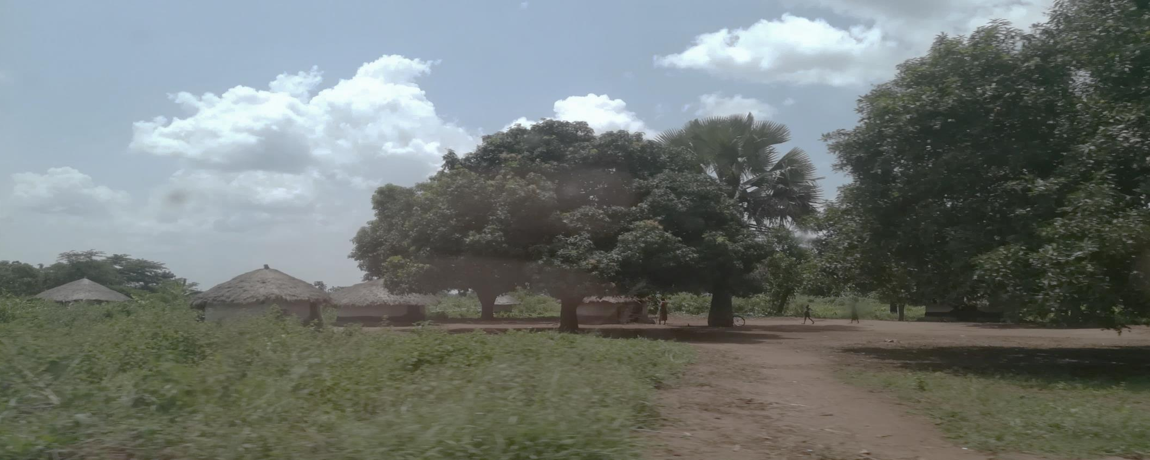
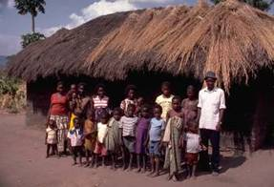
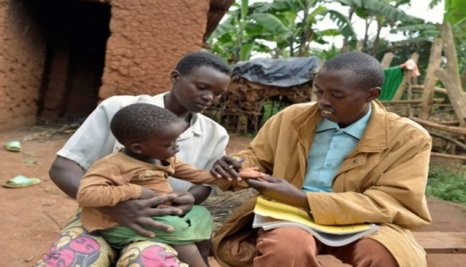
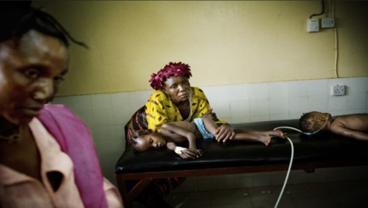
Remote rural environment,
high malaria transmission
Children < 5 years with severe fever
Community health worker practicing iCCM
Referral
Referral health facility, treatment of severe malaria
Pre-referral RAS
and referral

Slide 7
CARAMAL: Community access to rectal artesunate for malaria
Goal: Contribute to reducing malaria mortality in children by improving the community management of suspected severe malaria
Advance the development of operational guidance for the scale-up of pre-referral RAS for severe malaria
Generation of evidence:
Minimal requirements to ensure that RAS is an effective part of the continuum of care
Unintended consequences of scaled implementation; use beyond recommended guidelines?
Impact on severe malaria case fatality under real-world conditions
Costs and cost-effectiveness of scaling up RAS
With funding from

Slide 8
CARAMAL: generation of evidence
Before-and-after plausibility design (9 months baseline pre-RAS, 18 months with RAS)
Swiss TPH with local research partners (Makerere University School of Public Health, Kinshasa School of Public Health, Akena Associates)
Aligned with RAS roll-out through established community-based health care providers (UNICEF & local health authorities)
RAS + minimal supportive interventions
Additional supportive interventions
Baseline
Post-RAS introduction
Notes:
Roll-out of quality-assured rectal artesunate

Slide 9
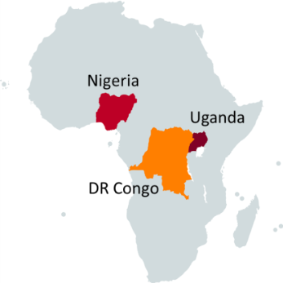
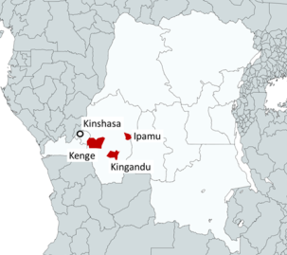
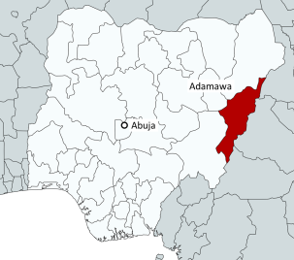
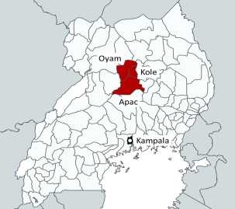
CARAMAL: generation of evidence
 | DRC | Nigeria | Uganda | Total
Project area | Kenge, Kingandu and Ipamu Health Zones | Adamawa State, Fufore, Mayo-Belwa, Song LGAs | Apac, Kole and Oyam Districts
Population | 619,000 | 689,000 | 992,000 | 2,300,000
Pop. <5 years | 112,000 | 212,000 | 176,000 | 500,000
Notes:
Roll-out of quality-assured rectal artesunate

Slide 10
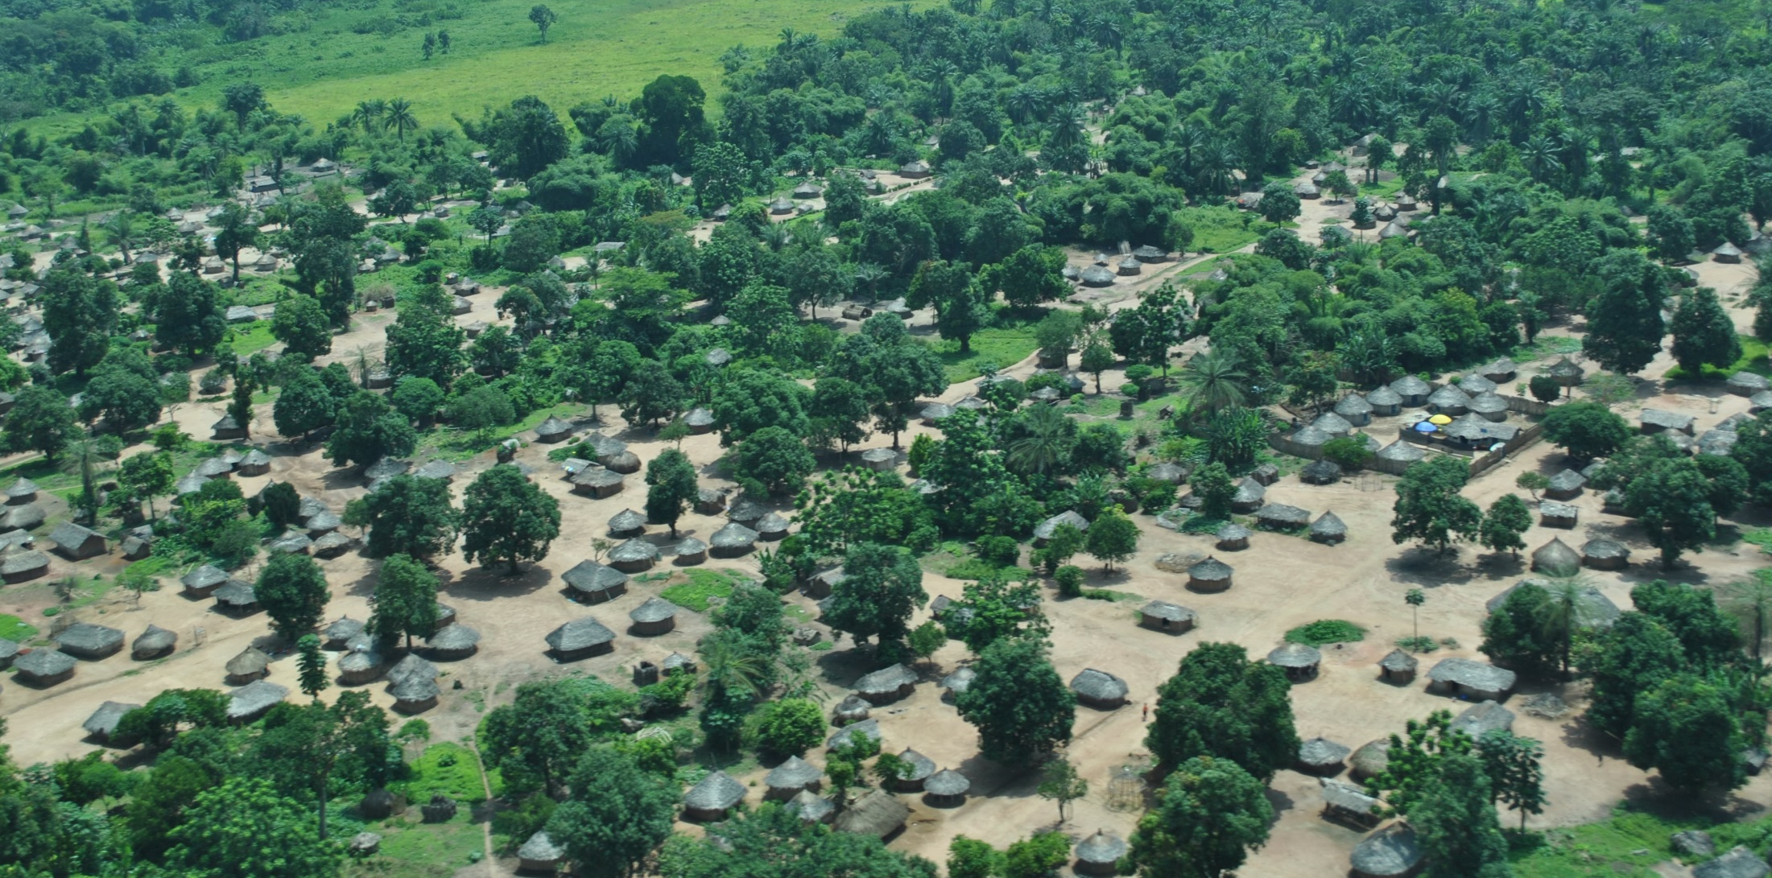



Referral pathway
Referral facility
Post-referral treatment
Inj. artesunate & ACT
CHW / primary
health facility
[RAS]
Referral advice
Successful referral
Community
Child with severe
febrile illness
Recovery/ death
Treatment seeking
Caregiver recognizes severity, seeks care
CHW recognizes symptoms & severity
Appropriate admin. of RAS
Referral advice
Referral completion
Proper post-referral management

Slide 11
Patient Surveillance System:
28-day follow-up of patients
Referral facility
Post-referral treatment
Inj. artesunate & ACT
1
CHW / primary
health facility
[RAS]
Referral advice
2
Enrolment
Treatment
history
Successful referral
Community
Child with severe
febrile illness
Recovery/ death
Treatment seeking
3
Day 28
Outcome

Slide 12
Surveys
Health Care Provider surveys
Referral facility
Post-referral treatment
Inj. artesunate & ACT
Household surveys
CHW / primary
health facility
[RAS]
Referral advice
Successful referral
Community
Child with severe
febrile illness
Recovery/ death
Treatment seeking

Slide 13
Preliminary findings: iCCM / facility coverage
 | DRC | Nigeria | Uganda | Total
Population <5 years | 127,000 | 212,000 | 176,000 | 500,000
iCCM providers (per cu5) | 28 (1.4/1,000) | 516 (2.4/1,000) | 4094 (23/1,000)
PHC | 52 | 65 | 44
Referral HF | 18 | 3 | 4
Functionality and coverage of iCCM systems varies largely between countries
In Nigeria, severe cases are rarely seen at CHW level
Notes:
Systems vary largely between countries
Major effort was required to include all providers in PSS
In Uganda, VHT are highly frequented, in Nigeria only rarely

Slide 14
Preliminary findings: severity of symptoms
  iCCM danger signs and severe malaria definition (WHO) do not completely allign
  No “severe malaria” classification at community level, hence reporting very difficult
  Danger signs not related to malaria (e.g. prolonged cough or diarrhoea) may lead to classification as suspected severe malaria (in PSS) and administration of RAS in the future
  Low case fatality (Uganda) suggests that many “severe malaria” cases may only be “moderately severe” or exhibit danger signs that are not life-threatening

Slide 15
Drug storage temperatures
Uganda (*health centre) Nigeria

Slide 16
Preliminary findings: treatment and referral pathways
  Referral pathway hierarchical in theory: CHW to refer patient to lowest level health facility, from there onward referral
  In practice, patients chose a wide variety of options
  Referral facilities are often first point of care (DRC, Nigeria)
  In some places, severe malaria cases are treated at lower level facilities:
      Recorded as uncomplicated malaria
      Treated with injectable drugs purchased by the patient
  Completion of referral may be low (62% in Uganda)

Slide 17
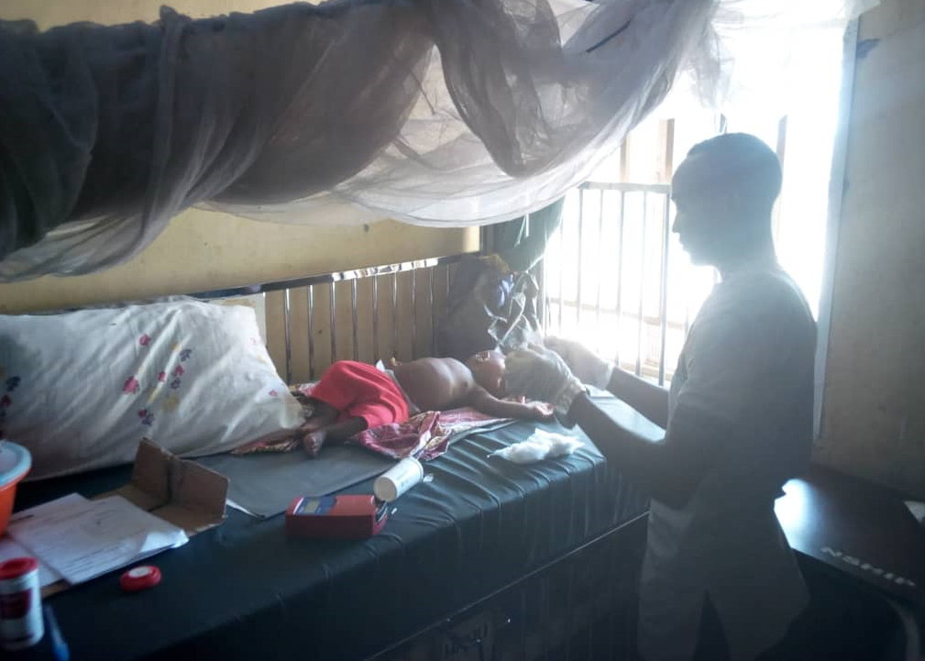
Preliminary findings: referral health facilities (RHF)
Frequent stock-outs of injectable artesunate and other commodities at RHF (DRC, Nigeria, Uganda)
  Quality of post-referral treatment of severe malaria often poor, e.g.
      Use of quinine instead of inj artesunate (DRC: >90% of RHF stock inj. quinine)
      Incomplete treatment with quinine
      No ACT
      Early discharge because of shortage of hospital beds

Slide 18
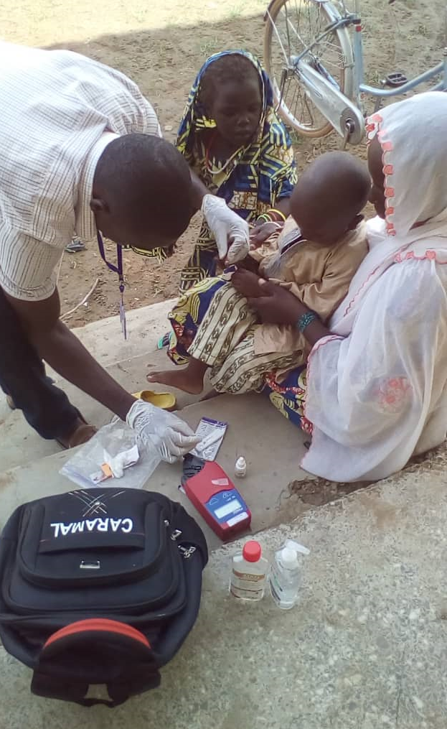
Preliminary findings: day 28 follow-up
Innovative way of assessing community-level outcomes of severe febrile illness
Requires a functioning near-real-time reporting system
~100% successful day 28 follow-up by country research teams
Increases interaction with CHW > positive impact on performance?
Day 28 RDT positivity: Uganda 67%, Nigeria 43%, DRC 59%
(real infections?)
Day 28 anaemia (<10g/dL): Uganda 32%, Nigeria 72%

Slide 19
Outlook
Pre-RAS baseline data by February 2019 (Patient surveillance system, household survey, health care provider survey)
    Treatment pathways
    Case fatality
    Availability and quality of severe malaria treatment services
  Introduction of RAS in February 2019
    Minimal supportive interventions
  Post-RAS assessment until mid-2020
  Prevalence of molecular markers for AS resistance pre- and post-RAS until mid-2020

Slide 20

*The CARAMAL Project consortium
Mila Nepomnyashchiy, Sumedh Ramachandra, Rebecca Goldstein, Jessica Fast, Thedoor Visser, Anita Mbadiwe, Justin Cohen & CHAI country teams
Christian Burri, Christian Lengeler, Manuel Hetzel, Aita Signorell, Nadja Cereghetti, Nina Brunner, Tom Smith, Aurelio Di Pasquale, Katya Galactionova, Nicole Humbert
Elizabeth Omoluabi, Babatunde Akano, Ocheche Yusuf & team
Antoinette Tshefu, Jean Okitawutshu & team
Pascal Ringwald, Silvia Schwarte
& team
Phyllis Awor,
Prossy Athieno
& team
Valentina Buj & UNICEF country teams
With funding from:

